Slide 1
Predicting the Antarctic Ozone Hole with Deep Learning
Project Development and process summary, by -
Aditya Choure
Vaishnavi Kadam

Slide 2
The Challenge & Project Motivation
The problem: The Antarctic ozone hole is a critical environmental indicator. Accurately forecasting its size is vital for assessing the effectiveness of global policies like the Montreal Protocol.
The Goal: To build a reliable time-series model using LSTM that predicts the mean area of the ozone hole using historical data on the primary drivers: ozone-depleting gases (ODGs).
Why now?: With decades of data available, we can leverage advanced machine learning techniques to uncover complex patterns and create a powerful predictive tool.

Slide 3
The Technical Approach
Model: Long-Short term memory (LSTM) network.
Why LSTM?: It is specifically designed to recognize long-term patterns in sequential data, making it ideal for time-series forecasting.
Features (Inputs): Historical concentrations of 9 key Ozone-Depleting Gases (e.g., CFC-11, CFC-12, Halons) from 1992 onwards.
Target (Output): The predicted "Mean ozone hole area" for a future year.

Slide 4
The Foundation: Data Sources
antarctic-ozone-hole-area.csv
This dataset contains yearly data on the area of the Antarctic ozone hole from NASA observations.
NASAOzoneWatch1.txt
This is a historical record of maximum daily ozone hole area and minimum daily ozone concentration in the Southern Hemisphere, on a yearly basis.
NASAOzoneWatch2.txt
This dataset provides averaged values for ozone hole size and ozone concentration during the core period of the ozone hole season (Sep–Oct).
odgi_table.csv
Contains global or regional ozone-depleting gas indicators, such as concentrations of various chemicals.

Slide 5
Pre-processing : From chaos to clean
Performed an initial inspection of the datasets to understand it’s structure and contents.
Converted relevant columns to numeric types for easier analysis and consistency.
Identified and addressed missing values by replacing them with appropriate values.
Aligned the dataset according to the year and successfully merged related datasets to create a unified dataset.

Slide 6
LSTM: learned to see the past to predict the future
LSTM (Long Short-Term Memory) is a type of Recurrent Neural Network (RNN).
It overcomes the vanishing gradient problem seen in traditional RNNs.
Uses gates (input, forgot, output) to manage what information to keep, update or discard.
Why it fits our case use:
LSTM is ideal for our dataset as it captures temporal dependencies, trends
and seasonality in time-series data more effectively than standard models.

Slide 7
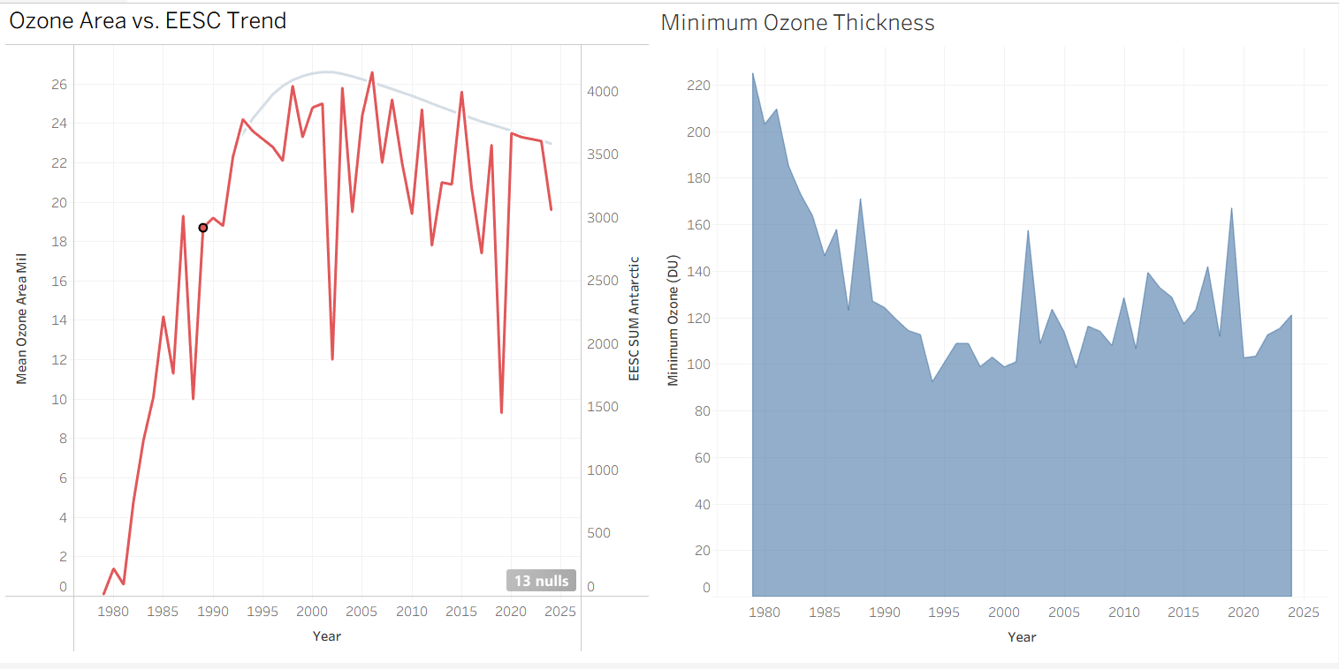
Data Visualization

Slide 8
Conclusion
Conclusion:
The data provides undeniable evidence that coordinated, science-driven international policy can successfully reverse major environmental damage.
The recovery is a long-term process, but the positive trend is clear.

Slide 9
Future Enhancements
Incorporating additional datasets and different features such as Landmass, satellite imagery, volcanic activity, solar activity to imporive accuracy of the predictive model.
Visualizing “What-if” scenarios
Automate pipeline to pull latest ozone watch data from NASA to refresh predictions quickly.

Slide 10
Ensuring Relevance: Stakeholder survey
A model is only useful if it answers the right questions for the right audience.
We gathered feedback from several people regarding our project with key questions asking about the relevance and need of this project, objective, features and any suggestions/comments regarding to that.
The feedback was screened (and implemented if it was worth it) to achieve the final model necessary which was deployed using streamlit.

Slide 11
Thank you!

